Slide 1
Python Programming Language Foundation
Session 3

Slide 2
Session overview
VCS
Git
Clone
Commit
Push/Pull
Log/Diff
Merge
Branches
Python Programming Solutions ©
2

Slide 3
VCS
Python Programming Solutions ©
3

Slide 4
VCS overview
Version control is a system that records changes to a file or set of files over time so that you can recall specific versions later.
Python Programming Solutions ©
4

Slide 5

Local VCS
Python Programming Solutions ©
5

Slide 6
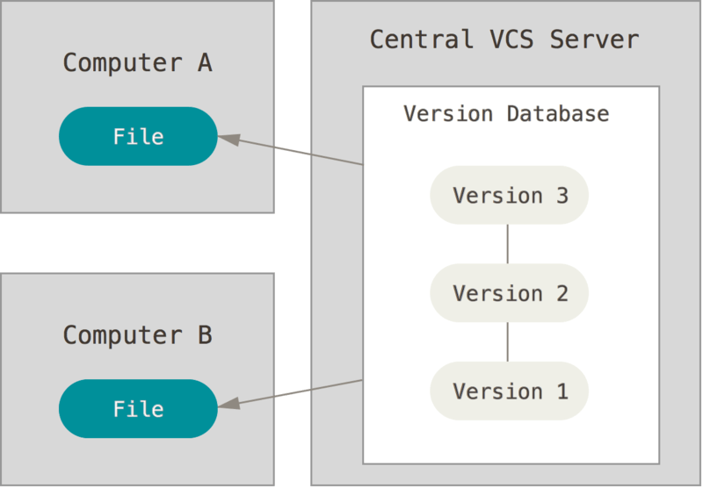
Centralized VCS
Python Programming Solutions ©
6

Slide 7
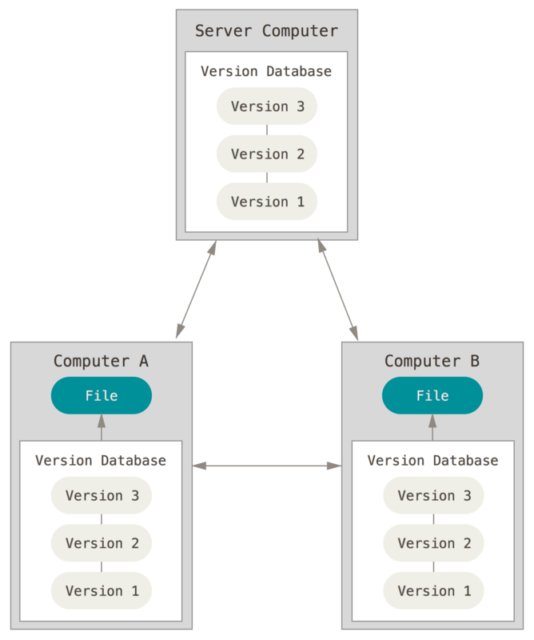
Distributed VCS
Python Programming Solutions ©
7

Slide 8
GIT
Python Programming Solutions ©
8

Slide 9
Git Features
Distribution
Size and Speed
Data Assurance
Open Source
Branching and Merging
https://git-scm.com/about
Python Programming Solutions ©
9

Slide 10
File states
The ”git commit” command captures a snapshot of the project's currently staged changes.
“git add” tells that you want to include updates to a particular file in the next commit.
Working directory
add
Staging area
commit
Repository
Python Programming Solutions ©
10

Slide 11
Commits and Branches
A branch in Git is simply a lightweight movable pointer to one of commits.
Master
Python Programming Solutions ©
11

Slide 12
Commits and Branches
A branch in Git is simply a lightweight movable pointer to one of commits.
Master
Python Programming Solutions ©
12

Slide 13
Commits and Branches
Branching means, you diverge from the main line of development and continue to do work without messing with that main line.
vb
Feature
Master
Python Programming Solutions ©
13

Slide 14
Commits and Branches
Branching means, you diverge from the main line of development and continue to do work without messing with that main line.
vb
Feature
Master
Bugfix
Python Programming Solutions ©
14

Slide 15
Commits and Branches
Branching means, you diverge from the main line of development and continue to do work without messing with that main line.
vb
*HEAD
Feature
Master
Bugfix
Python Programming Solutions ©
15

Slide 16
Commit
Python Programming Solutions ©
16

Slide 17
Create Commit
user@user:~$ git add <filename>
user@user:~$ git commit –m “here should be a clear message”
CO
C1
C2
*HEAD
Master
Python Programming Solutions ©
17

Slide 18
Create Commit
user@user:~$ git add <filename>
user@user:~$ git commit –m “here should be a clear message”
*HEAD
CO
C1
C2
C3
Master
Python Programming Solutions ©
18

Slide 19
Git Add
add changes in working directory to the staging area:
user@user:~$ git add <filename> [<filename>]
command accepts wildcards as parameters:
user@user:~$ git add *.py
dot ‘.’shortcut is used to add all files:
user@user:~$ git add .
to track current changes, use git status:
user@user:~$ git status
Python Programming Solutions ©
19

Slide 20
Git Commit
“git commit” is used to commit the staged files to the repo. The predefined file editor will be opened to allow you to add commit message:
user@user:~$ git commit
use -m parameter to add inline commit message instead:
user@user:~$ git commit -m “my first commit”
add staged changes to the last commit:
user@user:~$ commit --amend
Python Programming Solutions ©
20

Slide 21
Branches
Python Programming Solutions ©
21

Slide 22
Branching
View the list of existing branches:
user@user:~$ git branch
Create a new branch
user@user:~$ git branch feature
C0
C1
C2
*HEAD
master
Python Programming Solutions ©
22

Slide 23
Branching
View the list of existing branches:
user@user:~$ git branch
Create a new branch
user@user:~$ git branch feature
C0
C1
C2
feature
*HEAD
master
Python Programming Solutions ©
23

Slide 24
Branching
Switch to the branch:
user@user:~$ git checkout feature
Short alias to create new branch and switch to it:
user@user:~$ git checkout -b feature
*HEAD
C0
C1
C2
feature
master
Python Programming Solutions ©
24

Slide 25
Branching
Switch to the branch:
user@user:~$ git checkout feature
Short alias to create new branch and switch to it:
user@user:~$ git checkout -b feature
C3
*HEAD
feature
C0
C1
C2
master
Python Programming Solutions ©
25

Slide 26
Merging
Python Programming Solutions ©
26

Slide 27
Merging
Let’s imagine you have the repository visualised below, and you need to have your feature in the master branch.
C0
C1
C2
C4
*HEAD
Master
C3
C5
Feature
Python Programming Solutions ©
27

Slide 28
Merging
You can use git merge command.
Git creates a new snapshot and automatically creates a new commit that points to it. This is referred to as a merge commit and is special in that it has more than one parent:
user@user:~$ git merge feature
C0
C1
C2
C4
C6
*HEAD
Master
C3
C5
Feature
Python Programming Solutions ©
28

Slide 29
Rebasing
Python Programming Solutions ©
29

Slide 30
Rebasing
Rebasing is the process of moving the base of your branch from one commit to another making it appear as if you'd created your branch from a different commit.
user@user:~$ git rebase master
C0
C1
C2
C4
Master
C3
C5
*HEAD
Feature
Python Programming Solutions ©
30

Slide 31
Rebasing
Rebasing is the process of moving the base of your branch from one commit to another making it appear as if you'd created your branch from a different commit.
user@user:~$ git rebase master
C0
C1
C2
C4
Master
C3
C5
*HEAD
Feature
Python Programming Solutions ©
31

Slide 32
Rebasing
Don’t rebase a branch unless you are the only one who uses it!
Python Programming Solutions ©
32

Slide 33
Getting a repository
Python Programming Solutions ©
33

Slide 34


Getting a repository
Create a new repository:
user@user:~$ git init
Get existing repository:
user@user:~$ git clone https://github.com/username/repo
Default name for remote repository: origin
git clone
Remote
Python Programming Solutions ©
34

Slide 35
Pushing and pulling changes from the server
Python Programming Solutions ©
35

Slide 36
Pushing changes
Updates remote refs using local refs. Simply pushes your changes to remote repository.
user@user:~$ git push
C0
C1
C2
Local repository:
master
C0
C1
Remote repository:
origin/master
Python Programming Solutions ©
36
Notes:
36

Slide 37
Pushing changes
Updates remote refs using local refs. Simply pushes your changes to remote repository.
user@user:~$ git push
C0
C1
C2
Local repository:
master
C0
C1
C2
Remote repository:
origin/master
Python Programming Solutions ©
37
Notes:
37

Slide 38
Pulling changes
Works like a combination of fetch and merge commands for your local changes.
Takes changes from remote repository and tries to merge them to your local one.
user@user:~$ git pull
C0
C1
Local repository:
master
C0
C1
C2
Remote repository:
origin/master
Python Programming Solutions ©
38

Slide 39
Pulling changes
Pull works like a combination of fetch and merge commands for your local changes.
Takes changes from remote repository and tries to merge them to your local one.
user@user:~$ git pull
C0
C1
C2
Local repository:
master
C0
C1
C2
Remote repository:
origin/master
Python Programming Solutions ©
39

Slide 40
How to see commit history and file changes
Python Programming Solutions ©
40

Slide 41
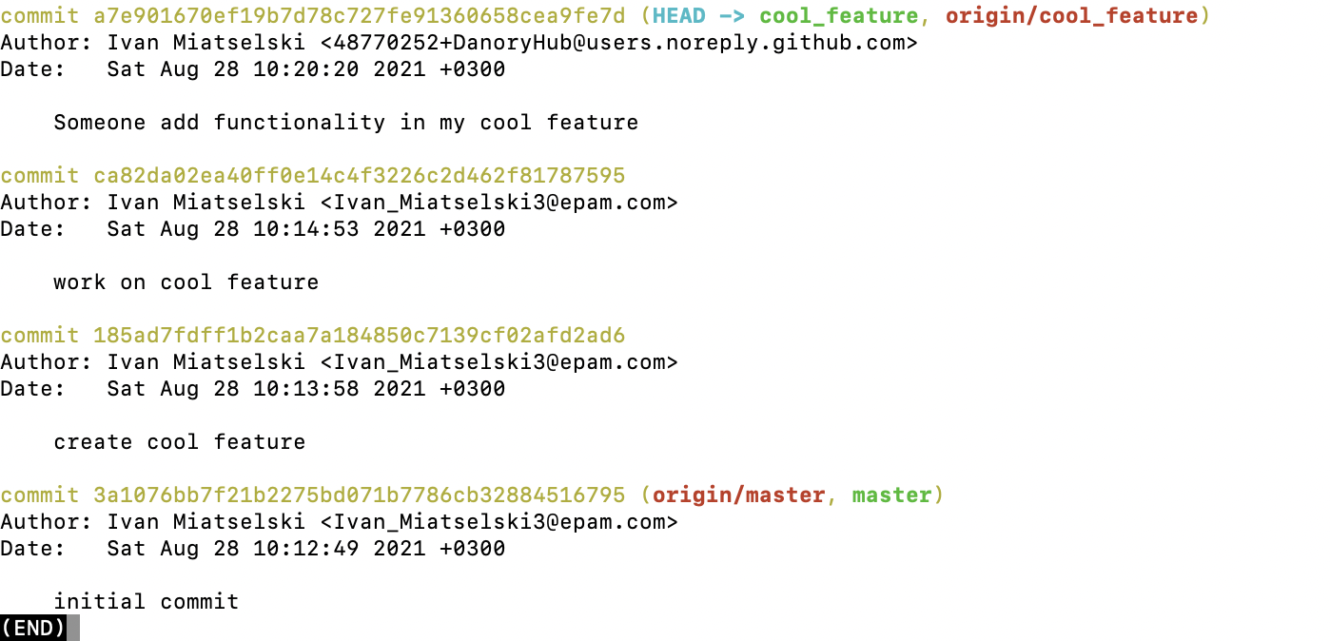
Commit history
Shows the full commit history:
user@user:~$ git log
Python Programming Solutions ©
41

Slide 42
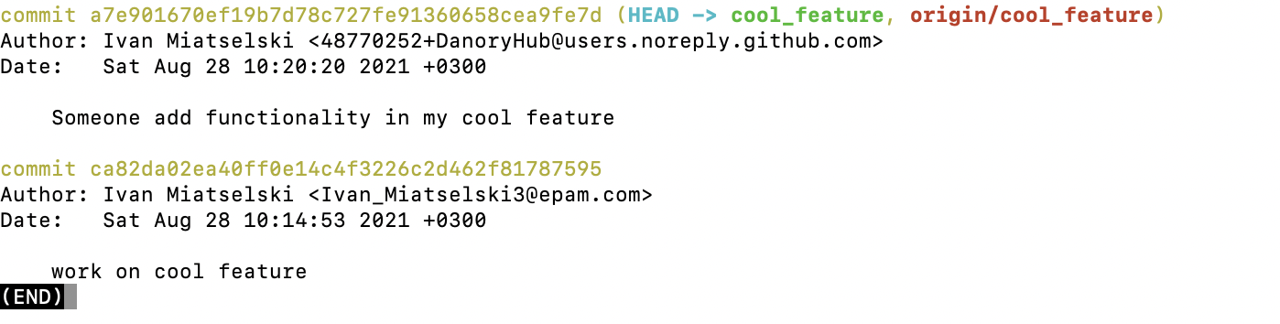
Commit history
List all the comments which are was made from <commit1> to <commit2> (<commit1> not included):
user@user:~$ git log <commit1>..<commit2>
Python Programming Solutions ©
42

Slide 43
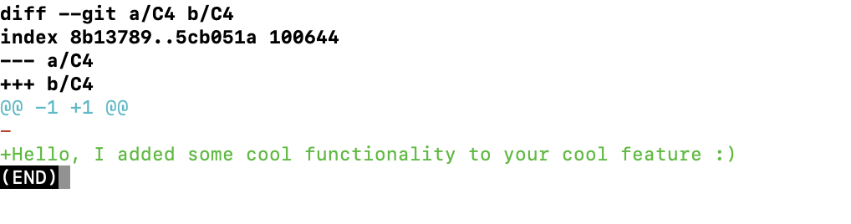
File changes
The git diff command shows the differences between the files in two commits
or between your current repository and a previous commit:
user@user:~$ git diff
Pushing and pulling changes from the server
Python Programming Solutions ©
43

Slide 44
Git installation
Python Programming Solutions ©
44

Slide 45
Installation
Git download page: https://git-scm.com/downloads
Ubuntu git install:
user@user:~$ sudo apt-get install git-all
MacOS:
user@user:~$ brew install git
Windows:
Follow the link: https://git-scm.com/download/win
Python Programming Solutions ©
45

Slide 46
Configuration
Write config value:
user@user:~$ git config --global <key> <value>
Examples:
user@user:~$ git config --global user.name "John Doe"
user@user:~$ git config --global user.email johndoe@example.com
Read config values:
user@user:~$ git config -l
user@user:~$ git config <key>
ssh generation: https://docs.github.com/en/github/authenticating-to-github/connecting-to-github-with-ssh/generating-a-new-ssh-key-and-adding-it-to-the-ssh-agent
Python Programming Solutions ©
46

Slide 47

Materials
Git branching interactive tutorial: https://learngitbranching.js.org/
Python Programming Solutions ©
47

Slide 48
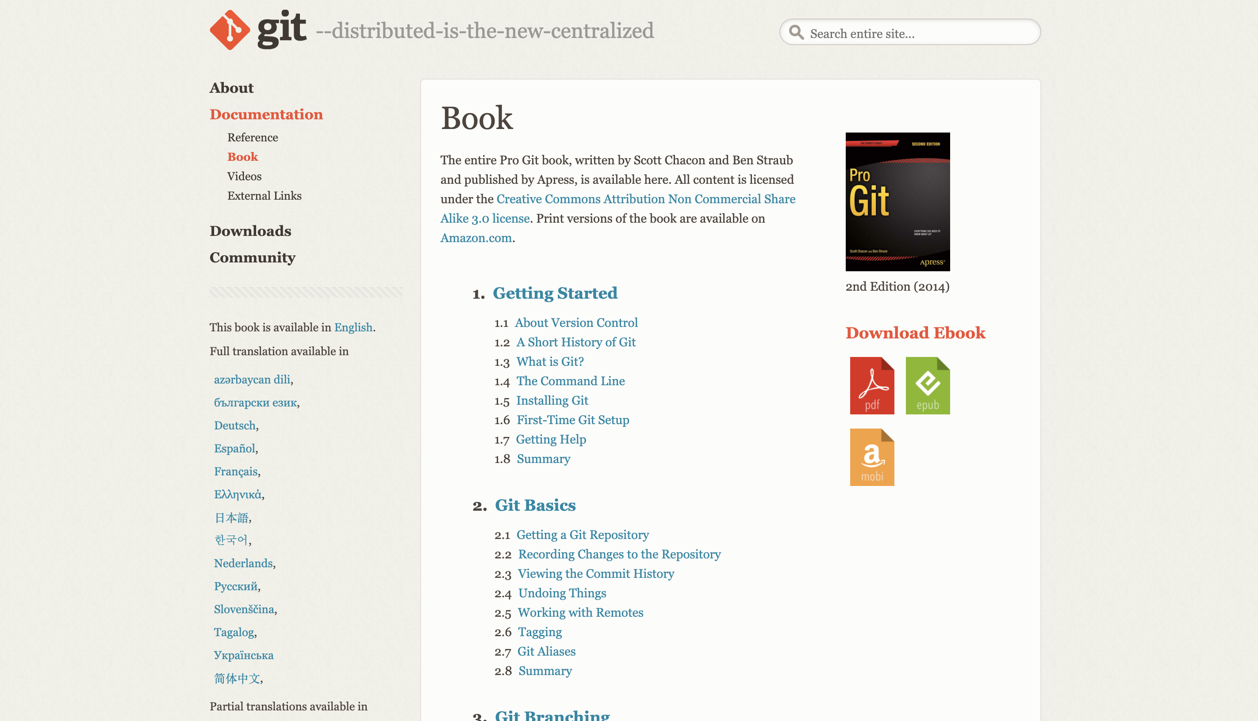
Materials
Pro Git book : https://git-scm.com/book/en/v2
Python Programming Solutions ©
48

Slide 49
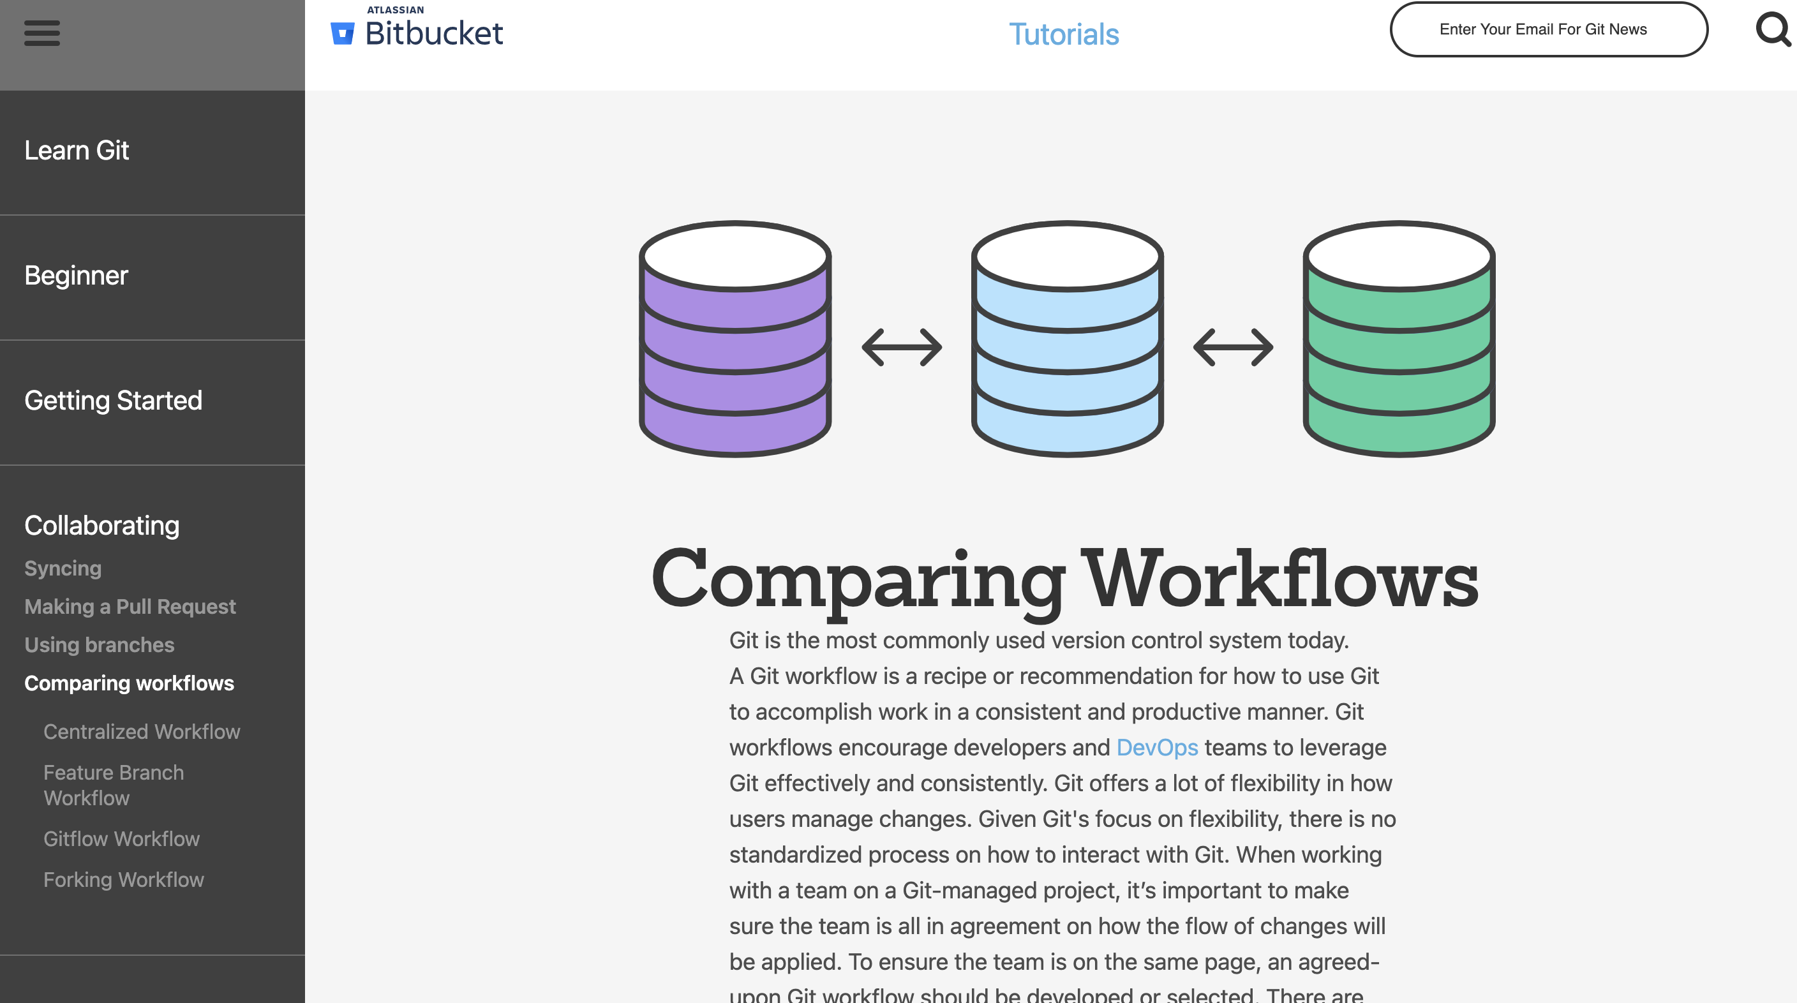
Materials
Comparing Workflows: https://www.atlassian.com/git/tutorials/comparing-workflows
Python Programming Solutions ©
49

Slide 50
Thanks for attention
Python Programming Solutions ©
50

